Slide 1
Lecture 1: Introduction to OpenCV
Instructor: Jianfeng(Jeff) Ren
Qualcomm Multimedia R&D

Slide 2
Pre requirement
1. Download visual studio 2015
Google “visual studio community edition”
2. Download OpenCV;
3. Download CMake

Slide 3
OpenCV Installation
Windows
http://docs.opencv.org/doc/tutorials/introduction/windows_install/windows_install.html
OpenCV on Linux:
http://docs.opencv.org/doc/tutorials/introduction/linux_install/linux_install.html#linux-installation
Using OpenCV with Eclipse (plugin CDT)¶
http://docs.opencv.org/doc/tutorials/introduction/linux_eclipse/linux_eclipse.html#using-opencv-with-eclipse-plugin-cdt
Mac
http://blogs.wcode.org/2014/10/howto-install-build-and-use-opencv-macosx-10-10/

Slide 4
Introduction to OpenCV Summer 2015, Tuesday/Thursday 7:00-9:00pm
Do you want to make your computer react human gestures? Do you want to make your car drive more safety? Do you want to make your home more security? Do you want to build one of the above systems with your hands? Get answers to all these questions and more at the Workshop “OpenCV”!
This class will get you prepared to quickly implement your computer vision related ideas using OpenCV.
Instructor:
Dr. Jianfeng(Jeff) Ren
Multimedia R&D, Qualcomm Inc

Slide 5
Abstract: OpenCV (Open Source Computer Vision) is a library of programming functions mainly aimed at real-time computer vision. And OpenCV has been used in many applications which includes Facial recognition system, Gesture recognition, Mobile robotics, stereo vision and Augmented reality.
The workshop is aimed at people with some programming knowledge, but not necessarily any computer vision knowledge. We will cover:
how to install and set up the Open Computer Vision toolkit,
computer vision algorithms: Image Features/Background Subtraction;
Machine Learning algorithm based on OpenCV;
a couple OpenCV demonstrations that you can use as a starting point for your own projects

Slide 6

Source code and document
Engineering process
Version control→ code review→ bug report etc.
https://github.com/jxr041100/OpenCV_UCSD_WORKSHOP/

Slide 7





OpenCV at glance
BSD license, 10M downloads, 500K+ lines of code
Huge community involvement, automated patch testing and integration process
Runs everywhere
Bindings: Python, Java
Samples, Apps, Solutions
OpenCV
Contrib
face, text, rgbd, …
core, imgproc, objdetect …
OpenCV
OpenCV HAL
SSE, NEON, IPP, OpenCL, CUDA, OpenCV4Tegra, …
Source from: OpenCV 2015 CVPR Tutorial

Slide 8
OpenCV History
Magic Leap
Renewed
Intel Support
OpenCV
Foundation
Nvidia Support
Intel Support
Willow Support
Release 2.0. C++
Release 2.1. Full Python support
Alpha Release at CVPR 2000. Windows only.
Release 2.2. Android Support
Beta 1. Linux support
Release 2.3. GPU Support. Modules
Release 2.4 LTS
OpenCV Started
Release 1.0
Release 1.1
Release 3.0 Refactored
1999
2000
2001
2002
2003
2004
2005
2006
2007
2008
2009
2010
2011
2012
2013
2014
2015
Development team has moved to Itseez
Google Summer of Code

Slide 9
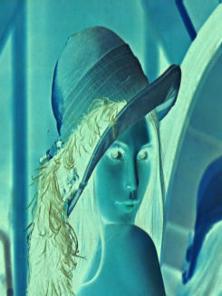

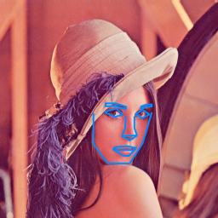
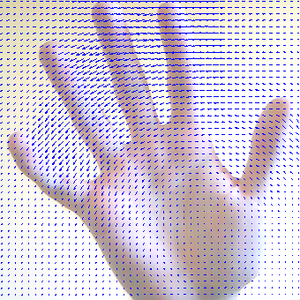

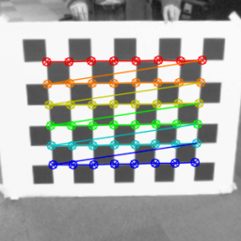
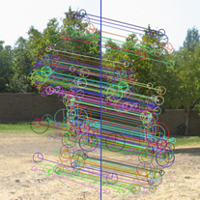

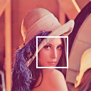
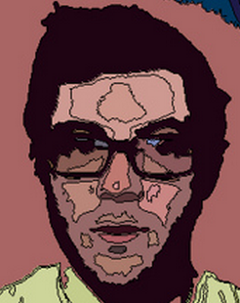
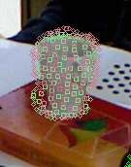
OpenCV Algorithm Modules Overview
HighGUI:
I/O, Interface
Image Processing
Transforms
Fitting
Optical Flow
Tracking
Segmentation
Calibration
Features
VSLAM
Depth, Pose
Normals, Planes, 3D Features
Object recognition Machine learning
Computational Photography
CORE:
Data structures, Matrix math, Exceptions etc

Slide 10
OpenCV Applications
IP Camera Surveillance;
Advanced Driver Assist System;
Drone;
Robotics;
Action Camera;
Digital Wearables;

Slide 11


Slide 12
The easiest way to start with OpenCV
clone http://github.com/itseez/opencv & opencv_contrib
build it; do not install it!
use the following CMake file for you sample
cmake_minimum_required(VERSION 2.8)
project(myopencv_sample)
find_package(OpenCV REQUIRED)
include_directories(${OpenCV_INCLUDE_DIRS})
set(the_target "myopencv_sample")
add_executable(${the_target} main.cpp) # add other .cpp
# and .h files here
target_link_libraries(${the_target} ${OpenCV_LIBS})
locate OpenCVConfig.cmake when cmake complains
you are good to go!

Slide 13
Tools required to be installed
An IDE of choice (preferably), or just a CC++ compiler that will actually make the binary files. Here we will use the Microsoft Visual Studio. However, you can use any other IDE that has a valid CC++ compiler.
CMake, which is a neat tool to make the project files (for your chosen IDE) from the OpenCV source files. It will also allow an easy configuration of the OpenCV build files, in order to make binary files that fits exactly to your needs.
Git to acquire the OpenCV source files. A good tool for this is TortoiseGit. Alternatively, you can just download an archived version of the source files from our page on Sourceforge

Slide 14
Third-party Libs required
The Python libraries are required to build the Python interface of OpenCV. For now use the version 2.7.x. This is also a must if you want to build the OpenCV documentation.
Numpy is a scientific computing package for Python. Required for the Python interface.
Intel © Threading Building Blocks (TBB) is used inside OpenCV for parallel code snippets. Using this will make sure that the OpenCV library will take advantage of all the cores you have in your systems CPU.
Intel © Integrated Performance Primitives (IPP) may be used to improve the performance of color conversion, Haar training and DFT functions of the OpenCV library. Watch out, since this isn’t a free service.
OpenCV offers a somewhat fancier and more useful graphical user interface, than the default one by using the Qt framework. For a quick overview of what this has to offer look into the documentations highgui module, under the Qt New Functions section. Version 4.6 or later of the framework is required.
Eigen is a C++ template library for linear algebra.
The latest CUDA Toolkit will allow you to use the power lying inside your GPU. This will drastically improve performance for some algorithms (e.g the HOG descriptor). Getting more and more of our algorithms to work on the GPUs is a constant effort of the OpenCV team.
OpenEXR source files are required for the library to work with this high dynamic range (HDR) image file format.
The OpenNI Framework contains a set of open source APIs that provide support for natural interaction with devices via methods such as voice command recognition, hand gestures and body motion tracking.
Miktex is the best TEX implementation on the Windows OS. It is required to build the OpenCV documentation.
Sphinx is a python documentation generator and is the tool that will actually create the OpenCV documentation. This on its own requires a couple of tools installed, We will cover this in depth at the How to Install Sphinx section.

Slide 15
The easiest way to start with OpenCV
typical OpenCV sample template
#include “opencv2/opencv.hpp” // joint “main” opencv header
// include opencv_contrib, hal etc. headers separately …
// make code wrist- and eyes-friendly
// … or put your code into cv[::nested_namespace] namespace
using namespace cv;
using namespace std;
// for most experiments you do not need full-scale GUI app.
// just do the things and display results with highgui
int main(int argc, char** argv) {
// dst is created automatically
Mat src = imread(argv[1]), dst;
…
imshow(“test”, src); // no need in namedWindows()
waitKey(); // do not forget it
return 0; // skip cleanup things
}

Slide 16
Image IO processing Template

Slide 17
Some other image processing algorithm
http://docs.opencv.org/modules/imgproc/doc/imgproc.html
Image Filtering
Geometric Image Transformations
Histograms
Feature Detection

Slide 18
OpenCV Video IO template.

Slide 19
Home work Assignment
Install OpenCV into your computer;
Install Cmake in your computer;
Install visual studio into your computer;
Trying to run one simple application.

